Slide 1
Input and Output in Java Lecture - 8
Prepared By - Rupali Patil

Slide 2
Contents
Scanner vs BufferedReader Class
Formatted output
Reading input from console

Slide 3


IO Hierarchy
Stream
Byte Stream
Char Stream
InputStream
OutputStream
Reader
Writer
Read ()
Write ()

Slide 4
IO Hierarchy contd..
Two major hierarchies in Java:
InputStream and OutputStream class hierarchy
This hierarchy enables data input-output in binary mode.
Reader and Writer class hierarchy
This hierarchy enables data input-output in text mode.

Slide 5
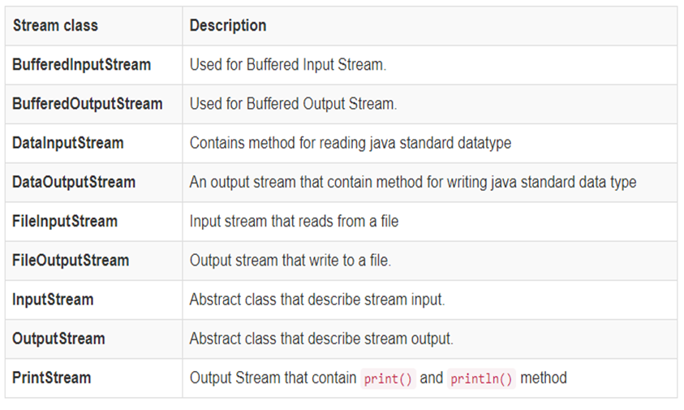
Input and output stream subclasses

Slide 6
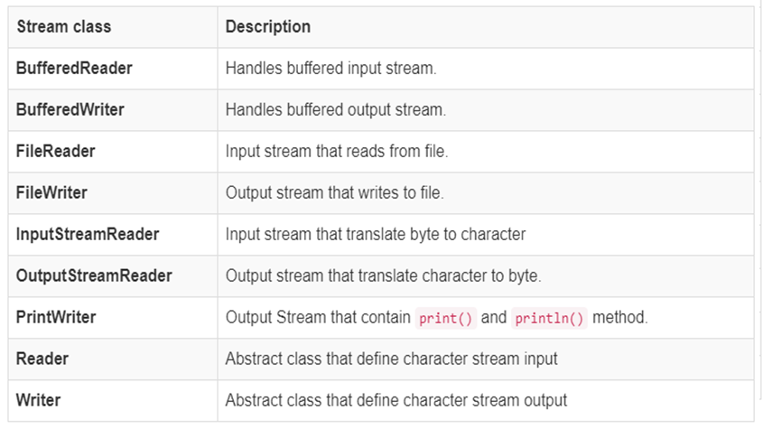
Reader and Writer subclasses

Slide 7
BufferedReader
This class provides a method :
int read() and String readLine()
Read text from a character-input stream ,buffering characters so as to provide fast and efficient reading of characters.
The BufferedReader reads characters from stream without causing device access every time.
Significant performance improvement
Read() operations are reduced

Slide 8

BufferedReader contd..
1010110010
1010110010
1010110010
1010110010
DeviceBuffer
System.in
InputStream Reader
Buffered Reader
KB
Java Application

Slide 9
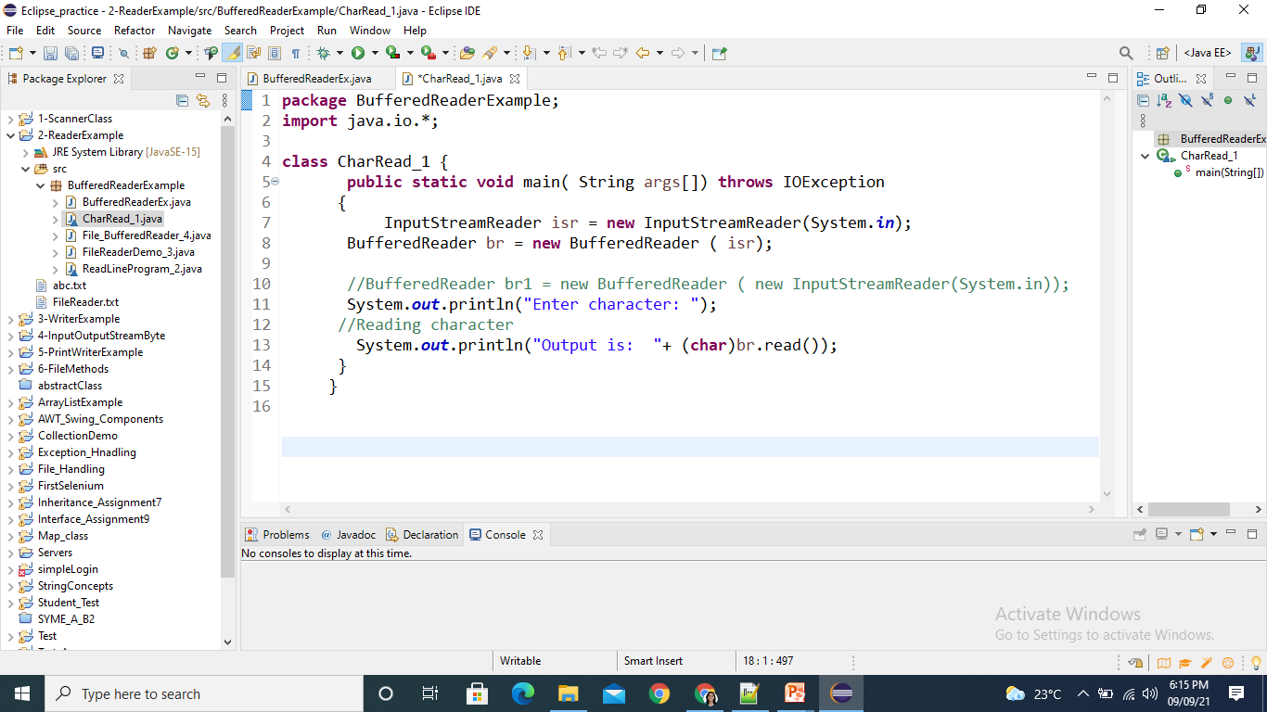
Example using BufferedReader
Program to read a character using read() method of BufferedReader class

Slide 10
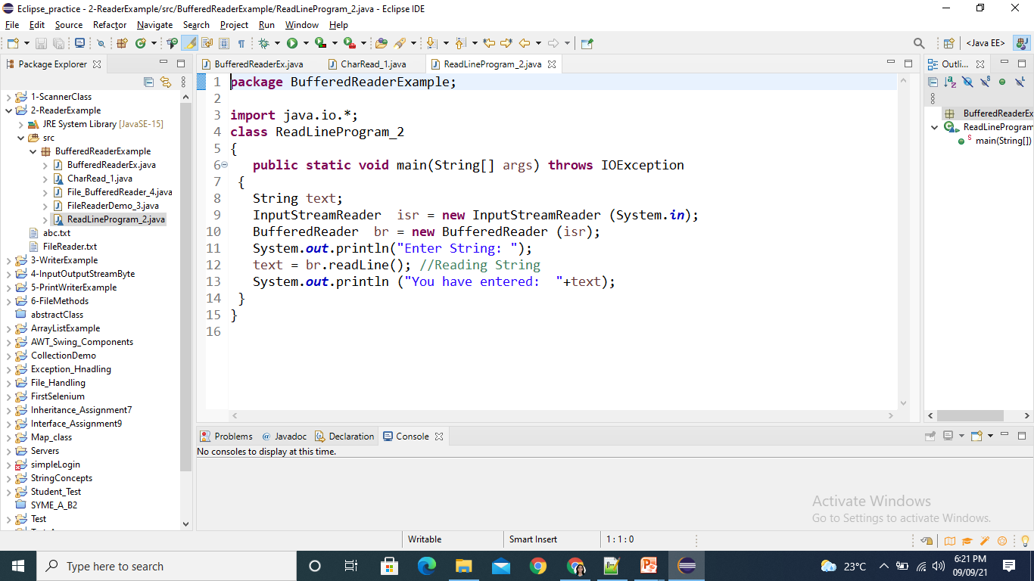
Example using BufferedReader
Program to take String input from Keyboard using readLine() method of BufferedReader class.

Slide 11
Scanner vs BufferedReader Class
Scanner class is a simple text scanner which can parse primitive types and strings.
BufferedReader class reads text from a character-input stream.
It buffers the characters so as to provide the efficient reading of sequence of characters.

Slide 12
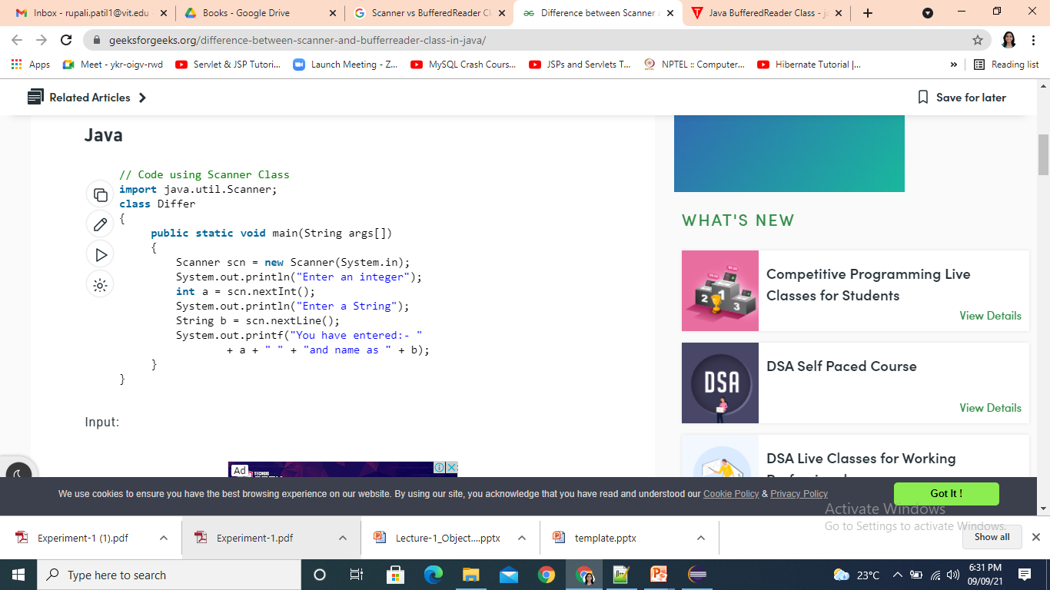
Scanner vs BufferedReader Class

Slide 13
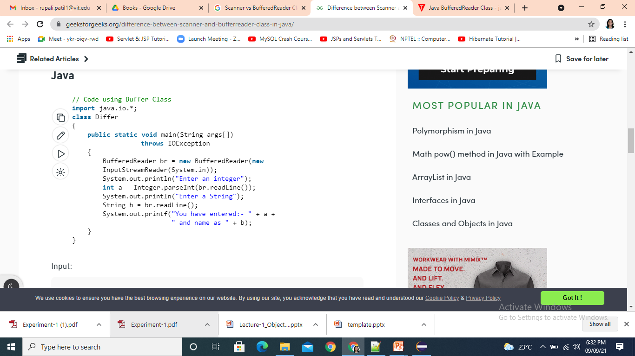
Scanner vs BufferedReader Class

Slide 14
Scanner vs BufferedReader Class
BufferedReader is synchronous while Scanner is not. BufferedReader should be used if we are working with multiple threads.
BufferedReader has significantly larger buffer memory than Scanner.
The Scanner has a little buffer (1KB char buffer) as opposed to the BufferedReader (8KB byte buffer).
BufferedReader is a bit faster as compared to scanner because scanner does parsing of input data and BufferedReader simply reads sequence of characters.

Slide 15
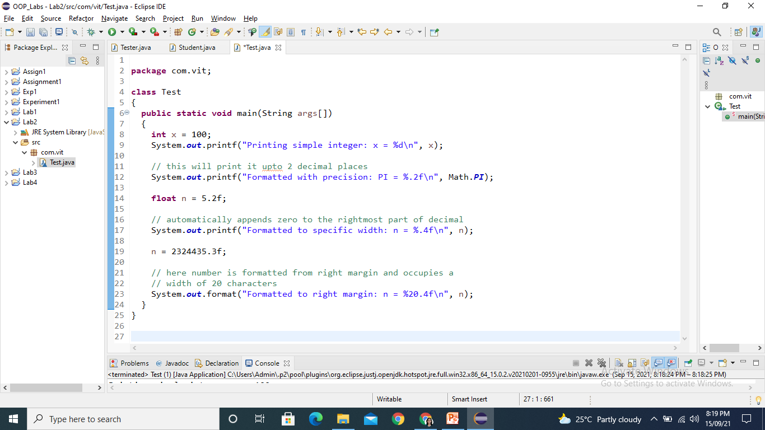
Formatted output
Formatting output using System.out.printf() and format()

Slide 16
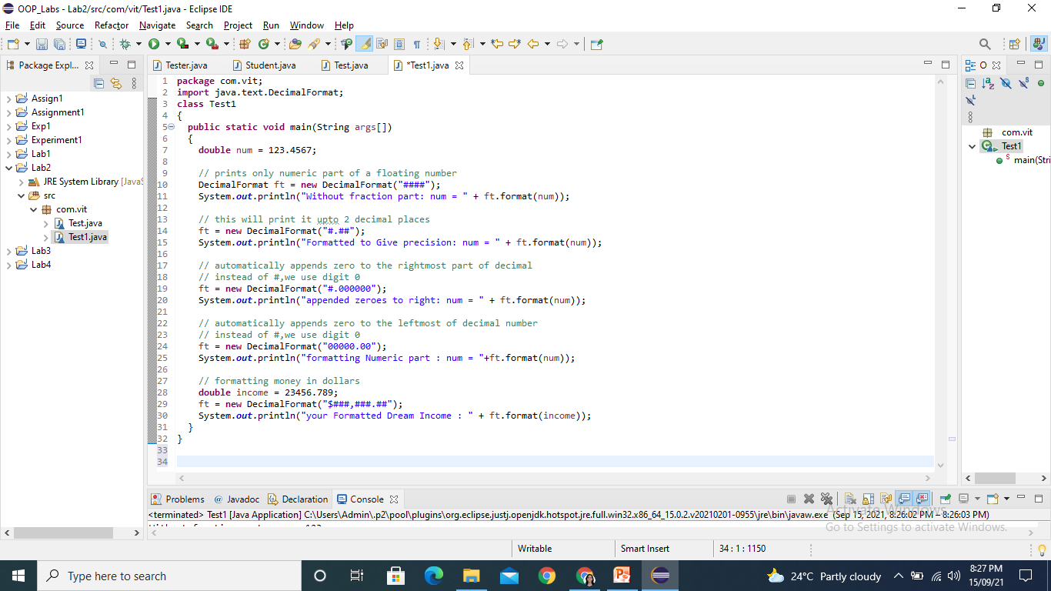
Formatted output
Formatting output using DecimalFormat Class:

Slide 17
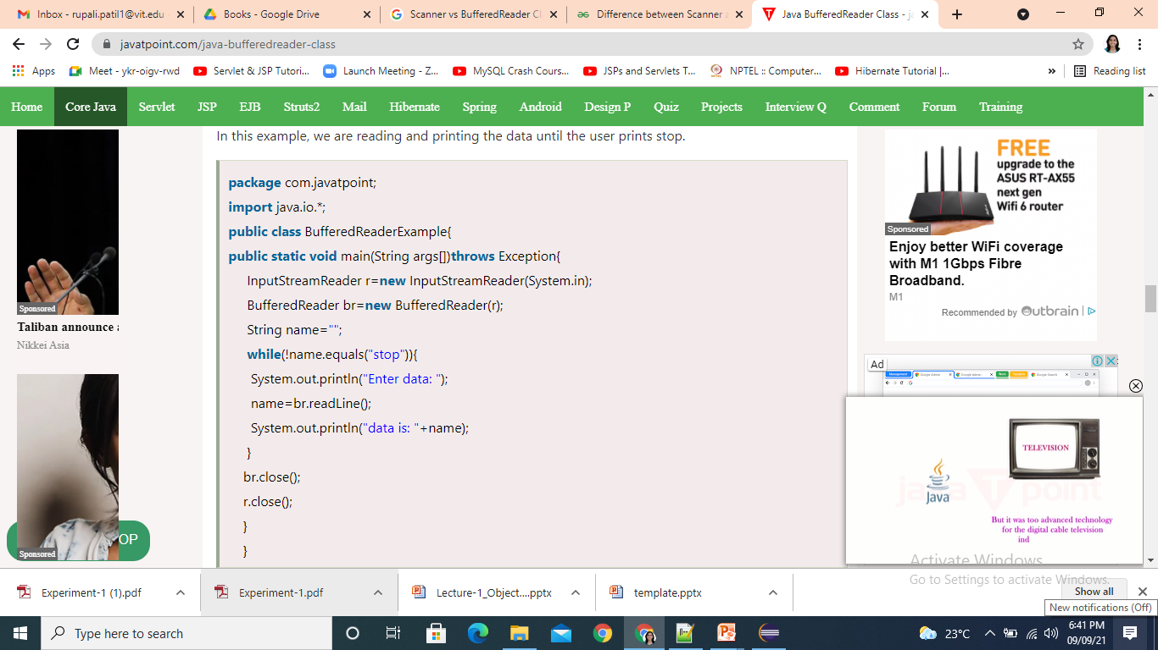
Reading input from console
For reading input from the console one can use scanner class as well as BufferefReader class.
Example: Reading data from console until user writes stop.

Slide 18
Thank You

